Slide 1
Advances in imaging strategies for in vivo tracking of extracellular vesicles
Presented by:
Azadeh Amini
Pharm D., PhD candidate of pharmaceutical biomaterials

Slide 2
The 2021-2022 Journal's IF : 9.182

Slide 3
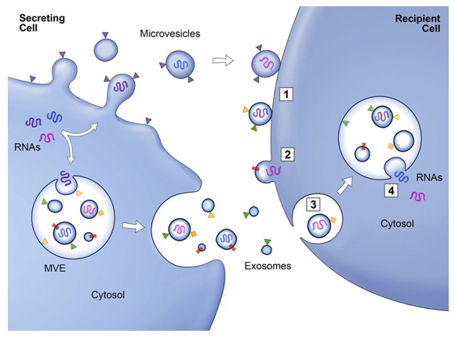
Extracellular vesicles (EV)
Extracellular vesicles (EVs) are lipid bilayer-enclosed nanoparticles released by cells.
They range from 30 nm to several micrometers in diameter, and ferry biological cargos such as proteins, lipids, RNAs and DNAs.
Extracellular vesicles (EV) have many biological functions as short- and long distance nanocarriers for cell-to-cell communication in both physiological and pathological conditions.
Homeostasis, immune response and angiogenesis

Slide 4
Tracking Extracellular vesicles
A major drawback for translating EV treatment to the clinic is that current understanding of these endogenous vesicles is insufficient, especially in regards to their in vivo behavior.
In vivo tracking of EV can provide important knowledge regarding their bio-distribution, migration, toxicity, biological role, communication capabilities, and mechanism of action.
Tracking EV in living organisms is challenging.
Due to the EVs' small size, their rapid dispersion in body fluids, and their composition, which is similar to that of body cells and therefore lacks contrast for imaging techniques.

Slide 5
In vivo imaging methods for EV tracking
Optical imaging
Fluorescence imaging
Bioluminescence
Nuclear imaging
Tomography
Magnetic resonance imaging (MRI)
Computed tomography (CT)
Photoacoustic imaging (PAI)

Slide 6
Optical imaging
Advantages:
wide spread technique in molecular and cellular biology
High-throughput efficiency
Low cost
Main types:
Fluorescence imaging (FLI)
using endogenous or exogenous molecules or materials which emit light upon activation by an external light source.
Bioluminescent imaging (BLI)
uses light generated from a natural biological process, that is, the luciferase enzyme-substrate reaction, and an ultrasensitive camera for signal detection.

Slide 7
Fluorescence imaging (FLI)
Using endogenous or exogenous molecules or materials which emit light upon activation by an external light source
Light sources:
Fluorescent proteins (such as GFP and RFP) are mostly introduced to the parent cells indirect labeling, that can shed light on the biological mechanisms that occur in the cell and involve EV biogenesis, secretion and communication
lipophilic dyes (such as Cy7 , PKH26, luminogens) are incorporated into the EV directly, provides insights mainly regarding their biodistribution and organotropic uptake
Easy to operate, enables to trace analytes in real time, noninvasive, nonionizing light-sources
Poor penetration depth and spatial resolution (unsuitable for clinical translation), lipophilic dyes promote EV aggregation, the presence of auto-fluorescence artifacts

Slide 8
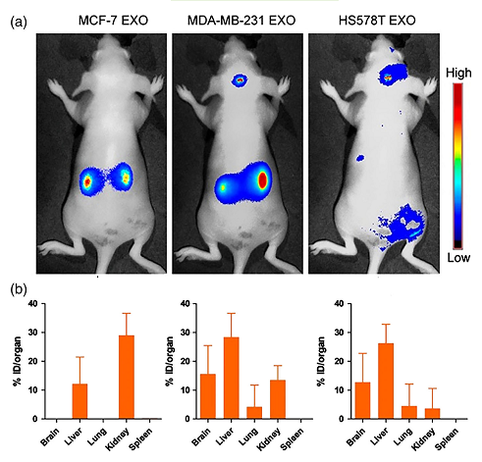
Fluorescence imaging (FLI)
Kinetics of breast-cancer-cell-derived exosomes 24 hr postexosomes injection. (a) Mice following intravenous injections of fluorescently labeled MCF-7-, MDA-MB-231-, and HS578T-derived exosomes. (b) Biodistribution of exosomes, analyzed and quantified by recoding the photons/second/steradian (ph/s/sr) of each organ, normalized to the injected dose fluorescence intensity. The results are expressed as the means ± SD( n = 3)

Slide 9
Bioluminescent imaging (BLI)
Uses light generated from a natural biological process, that is, the luciferase enzyme-substrate reaction, and an ultrasensitive camera for signal detection
Bioluminescence does not require an excitation source to emit light, but rather emits bioluminescence through reaction of the respective substrate with either ATP and Mg2+ or oxygen alone.
BLI's high sensitivity and low background signal qualities make luciferase a good reporter for in vivo studies.
Studies show that labeling of EV using bioluminescence reporters is safe for the EV, the bioluminescence protein is retained in the EV even after iv injection, and the method can be used for EV biodistribution studies.
BLI has an extremely low signal-to- noise ratio, due to a negligible auto luminescence in mammalian tissue.
Any in vivo imaging which is based on fluorescence is limited in resolution and penetration depth so it cannot give a clear picture of EV location in deep body structures (most studies rely on ex vivo imaging to validate the in vivo results).
This technique is mostly suitable for preclinical research, and will not be easily translated to the clinic.

Slide 10
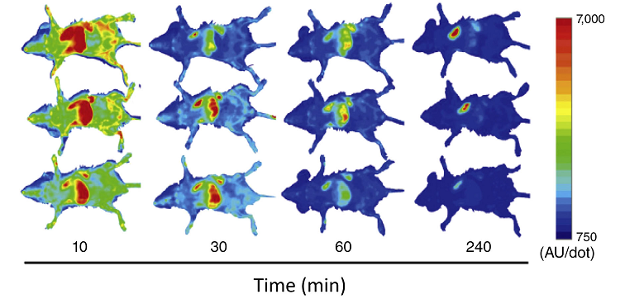
Bioluminescent imaging (BLI)
Kinetics of GLuc after intravenous injection of GL-labeled B16-BL6 EV into mice. Balb/c mice received intravenous injections of EV collected from pCMV-gLuc-lactadherin-transfected B16BL6 cells. B16-BL6 EV expressing gLuc were imaged 10, 30, 60, and 240 min post EV injection through a bolus intravenous injection of Coelenterazine.

Slide 11
Nuclear imaging
Nuclear imaging, involving the application of radioactive substances in the diagnosis and treatment of diseases, is broadly used for cellular imaging.
Radionuclides emit radiation which can be detected in vivo using a special camera.
In this method, the labeling agents are introduced directly to the EV through incubation, and 3D images are usually obtained using single-photon emission CT (SPECT) or positron emission tomography (PET) that can be combine d with anatomical imaging.
nuclear imaging enables visualization of deep structures and organs with its improved sensitivity and tissue penetration ability.
Though radionuclides have very short half-lives, which necessitate relatively short periods of imaging and tracking.
Taken together, radiolabeling gives a clear, deep-penetrating, and whole-body imaging of the EV, and can be combined with CT to provide simultaneous anatomical imaging.
However, many radionucleides have very short half-lives—most studies tracked EV using 99 Tc between 1 and 5 hr, while only ¹¹¹ In allowed a longer tracking period of up to 24 hr.

Slide 12
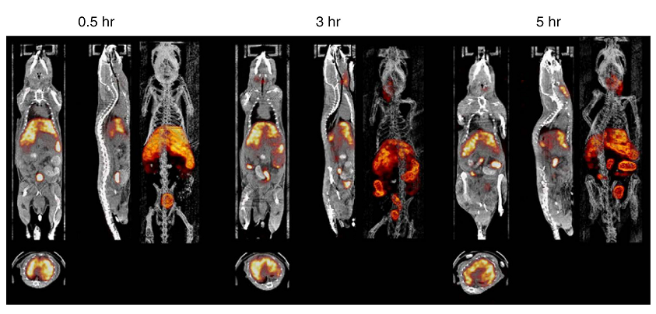
Nuclear imaging
In vivo single-photon emission computed tomography/computed tomography (SPECT/CT) images of 99mTc-HMPAO labeled EV post intravenous injection. Images were acquired at 30 min, 3, and 5 hr in BALB/c mice. The SPECT/CT imaging shows a significant uptake of radiolabeled EV in the liver, salivary glands and intestine up to 5 hr post administration.

Slide 13
Tomography
Tomography methods require the EV to be labeled with nano-particles as labeling agents.
Tomography techniques are considered to be efficient and noninvasive methods, are widely used, and can be easily translated to the clinic.
Tomography techniques are suitable for longitudinal tracking and localizing of EV and for visualizing EV over time.
Main types:
Magnetic resonance imaging (MRI)
In order to be detect-able by MRI, EV must be labeled with magnetic contrast agents, such as superparamagnetic iron oxide nanoparticles (SPIONs).
Computed tomography (CT)
CT provides superior visualization of bone structures due to the inherent contrast between electron-dense bones and the more permeable surrounding soft tissues. Therefore, CT has been used for cell tracking while combined with nanoparticles as labeling agents.
CT is characterized by high temporal and spatial resolution, and is among the most convenient imaging tool s used in hospitals to date in term s of availability, efficiency, and cost.

Slide 14
Magnetic resonance imaging (MRI)
In order to be detect-able by MRI, EV must be labeled with magnetic contrast agents, such as superparamagnetic iron oxide nanoparticles (SPIONs).
MRI has advantages such as being radiation-free and having high spatial resolution.
MRI enables longitudinal imaging—findings show imaging up to 12 days after iv injection with high resolution and maximal penetration into deep structures.
It must be taken into account that the nanoparticles may not all be contained within the EV for the entire duration, and the images may reflect entry of SPIONs into the cells after EV fusion, thus this modality does not necessarily provide information on EV final fate.

Slide 15
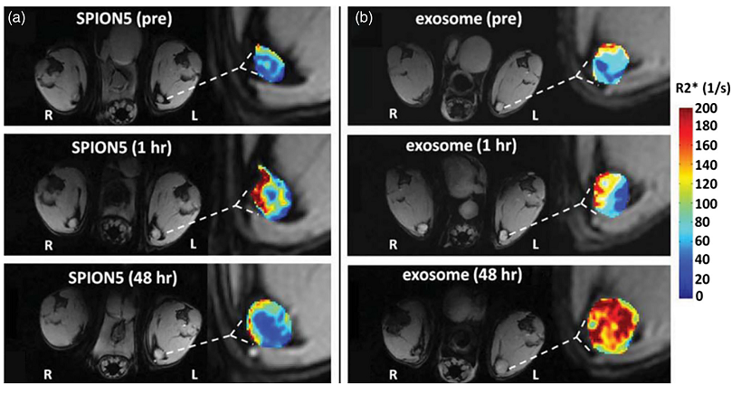
Magnetic resonance imaging (MRI)
In vivo MRI of SPION5 loaded melanoma EV. (a) Free SPION5 and (b) SPION5 loaded EV migrated to ipsilateral (left, L) and contralateral (right, R) popliteal lymph nodes (PLN) as visualized by T1-weighted images with R2* mapping of PLN ipsilateral to the injection site.

Slide 16
Computed tomography (CT)
CT provides superior visualization of bone structures due to the inherent contrast between electron-dense bones and the more permeable surrounding soft tissues. Therefore, CT has been used for cell tracking while combined with nanoparticles as labeling agents.
CT is characterized by excellent penetration and high temporal and spatial resolution, and is among the most convenient imaging tools used in hospitals to date in terms of availability, efficiency, and cost.
CT requires direct EV labeling, with all of the drawbacks associated with the process, such as not knowing whether the signals that appear in the images refer to actual EV or leaked or transferred contents.
There also exists the ionizing radiation issue associated with any CT imaging.

Slide 17
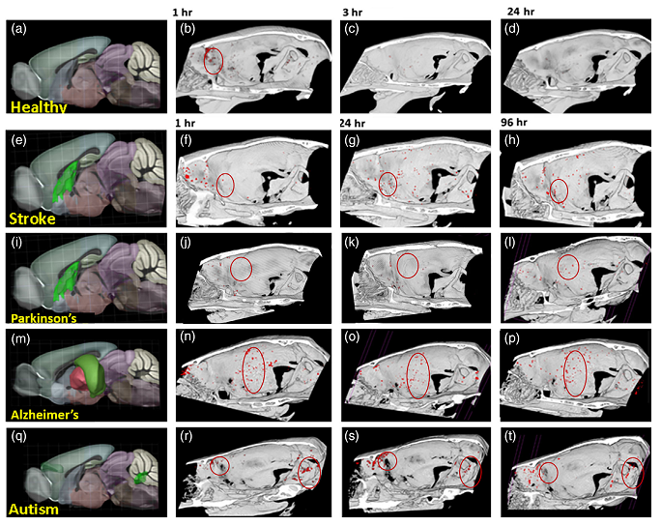
Computed tomography (CT)
(a) Longitudinal in vivo CT imaging of homing and accumulation of EV within the brain. (b–d) Healthy mice. CT signal, indicating presence of gold nanoparticle-labeled EV , is found mainly in the olfactory bulb at 1 hr, and cleared by 24 hr. (f–h) Stroke model: the EV CT signal was located in mouse striatum up to 96 hr. (j –l) Parkinson's disease model: EV signal was located in the striatum at 96 hr. (n –p) Alzheimer's model: EV signal was located in the hippocampus up to 96 hr. (r–t) Autism model: EV signal was located in the cerebellum and prefrontal cortex up to 96 hr. (a, e, i, m, q). Brain section images adopted from Allen Mouse Brain 3D atlas, showing the lesioned/pathological area in green.

Slide 18
Photoacoustic imaging (PAI)
PAI is based on the photoacoustic effect and combines ultrasound imaging with optical imaging. The contrast agent in the biological sample absorbs the pulsed laser radiation energy and converts it into an acoustic signal, which is then measured and visualized by a scanning transducer.
PAI is an attractive noninvasive imaging modality that combines the advantages of high spatial resolution and deep penetration of ultrasound imaging with the high-contrast of optical imaging.

Slide 19
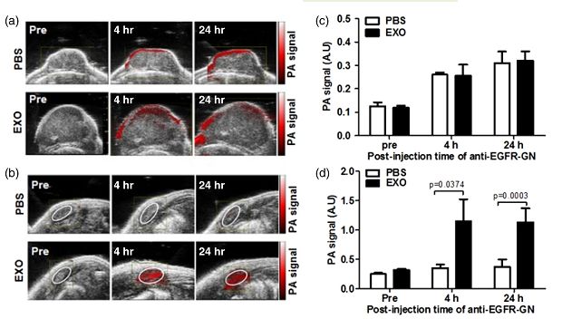
Photoacoustic imaging (PAI)
Photoacoustic imaging (PAI) of primary tumor growth and axillary lymph-nodes metastasis following intravenous (iv) injection of cancer cell-derived EV in triple-negative breast cancer models. (a) and (b) Representative ultrasound-guided PAI of mice that were injected iv with phosphate-buffered saline or EV before, 4 and 24 hr after intra-tumor injection of anti –EGFR-GN. (c and d) PA signals (mean ± SE)
measured from primary tumors (c) and axillary lymph-nodes (d). EV reached the tumor area and promoted its growth.

Slide 20
Conclusions
The EVs are indeed trackable within a living body. The various tracking methods can elucidate much of the unknown behavior and function of EV, differentiate between different EV types, define the role EVs play in disease, explore their capabilities in navigating throughout the body in terms of active distances and barrier penetration, and reveal how they interact with cells.
Some tracking modalities are mostly useful for preclinical studies (such as FLI and BLI), while others can easily be adapted from research to the clinic (such as CT, MRI, or PET).
The lack of standardization in EV isolation, purification, and characterization procedures hampers direct comparison between different findings. Different isolation and purification methods which affect EV purity and function may consequently have an impact on their in vivo biodistribution.
These issues are manifested by the lack of stating the amounts of EV injected, or the marking efficiency of EV, in many studies.
There is therefore a challenge for future research to make the tracking of EV more quantifiable and thus allow for more measureable comparisons between the different tracking modalities.
There has also not been a study to link between the traverse of EV across the body to their therapeutic abilities. A future study could incorporate artificial intelligence and machine.
learning in order to analyze such information and so be able to predict, soon after EV treatment is started and with the proper choice of imaging modality, whether the movements of the EV reveals a high or low chance of success for the treatment.

Slide 21
Thanks for your attention!

